Slide 1


INTB6200
Peloton in South Korea
By Anna Sromek, Brittany Isenhart, Chris Lyons, Rachit Pandya, Rishabh Sharma, and Sara Sherindil

Slide 2


About Peloton
Revolutionized home fitness by integrating high-quality equipment with engaging digital content
Global leader in the interactive fitness market with over 6 million subscribers and revenue of $3.57 billion in 2023
Currently operating in Australia, Canada, Germany, UK, and US

Slide 3

Product alignment with broader trends
Rising Fitness Trend → Workout equipment, club memberships, and fitness classes
Tech-Savvy Population → Innovative products offering live-streamed and demand-based lessons
Economic Prosperity → High GDP per capita of South Korea

Slide 4
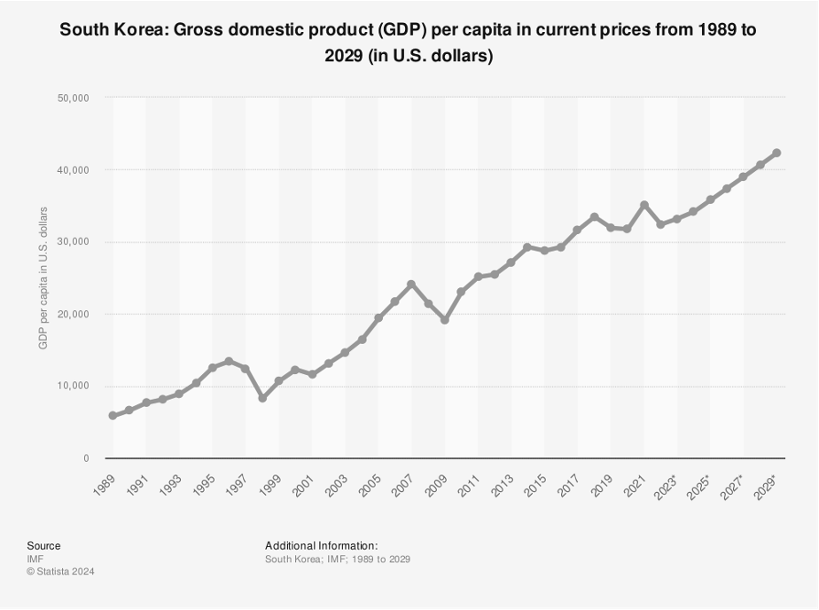

Slide 5

Outperforming Competitors
Exclusive classes tailored to Korean culture and interests
Korean language options for the classes.
Partnering with local gyms and popular Korean fitness influencers
Offering attractive maintenance and warranty options
Notes:
Such as popular local music, K-pop-themed workouts, celebrity trainers, and others.

Slide 6
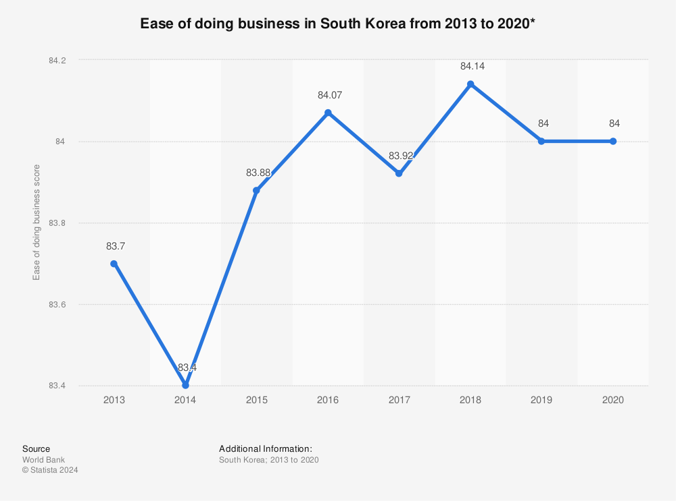
Franchising
Brand Recognition: Loyal base of customers
Lower Capital Investment: Franchisees bearing the costs
Local Expertise: Customer patterns, market dynamics, and regulatory framework
Shared Risk: Shared market entry risks with its franchisees
Regulatory Environment: Business-friendly policies

Slide 7

Other Key Entry Considerations
Differentiation Strategy
Polycentric Staffing Policy
Follower Time of Entry
Small-Scale Entry
Notes:
Differentiation Strategy
1) Global Brand Consistency; 2) Cost-Value Balance; 3) Competitive Advantage
Polycentric Staffing Policy to Balance Local and Home Country Expertise
Local Adaptation; 2) Global Consistency
Follower Time of Entry
1) Reduced first mover risks; 2) Lessons Learned from competitors
Small-Scale Entry
1) Reduced financial risk; 2) Longer learning curve; 3) Flexibility to adjust operations

Slide 8
Cultural & Social considerations
Hierarchical; chain of command
Respect superiors, authority
Initiative; self-reliance; merit
Groupist; consensus-seeking
Value teamwork, unity
Strong sense of “face”
Functions under rules and structure
Value quality, safety, luxury, status
Pragmatic; forward-thinking
Plan for future
Refrain from self-indulgence in deference to social norms
Source: https://www.hofstede-insights.com/country-comparison-tool

Slide 9
Personal Ethics
Societal Culture
Decision Making
Commitment, hard work, loyalty
Some corruption (on par with US)
Confucian influence: hierarchy; status
Interdependence; societal obligation
Maintain order: balance, reciprocity
Consensus; maintain “face”
Develop strong relationships
Formal meetings; hierarchical
Well-researched proposal
Decision at higher level; communicated later ↑/↓ chain
South Korea
Business ethics
Organizational Culture
Leadership
Driven by teamwork; hierarchy
Diligent, loyal, self-sacrificing
Sahoon is taken seriously
Nonconfrontational; indirect communication
Competitive pay; bonus; perks
Decision makers
Subordinates expected to obey
Autocratic but benevolent
Patient; promote harmony
Unrealistic Performance Goals
Culture set by leadership
Obedience, conformity valued
May behave unethically to avoid conflict

Slide 10
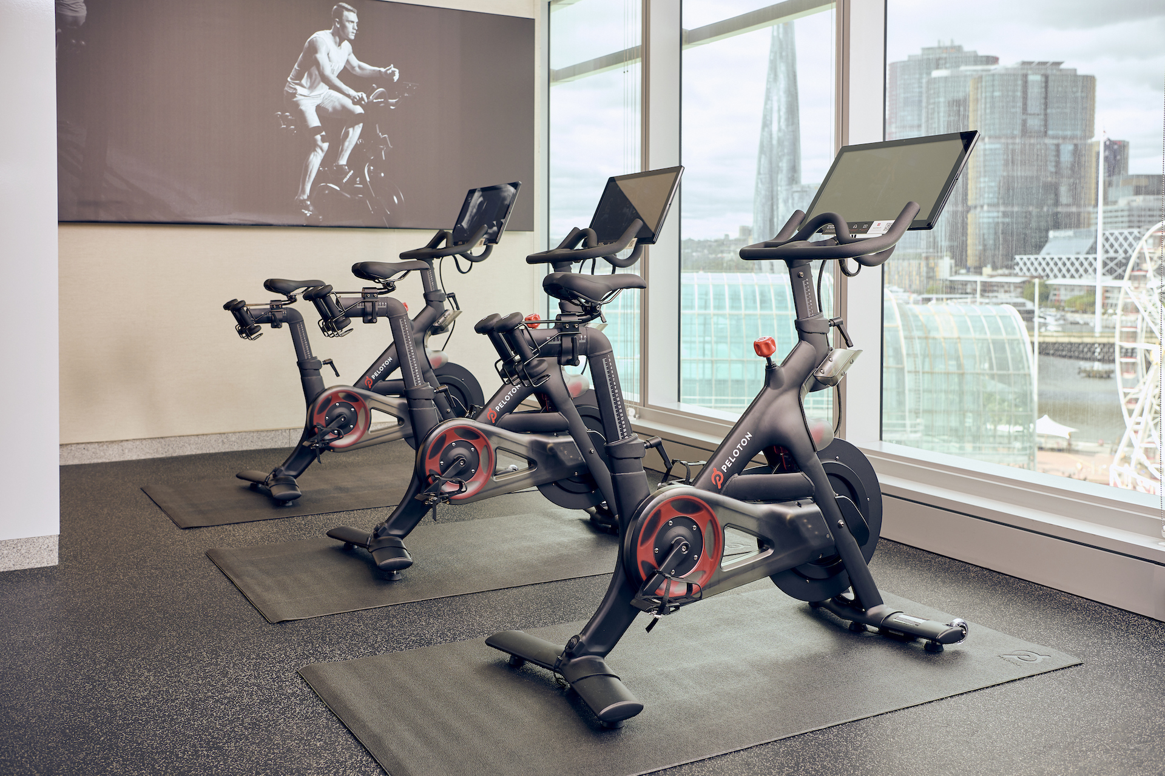
Recommendations based on cultural profile
Entry
Local team: industry experts, impactful connections
Cultivate long-term business relationships
Understand, follow social protocols
Introduce Peloton as an exclusive product
Marketing
Quality, luxury, status
Sense of unity, belonging
Health benefits; overall well-being
Strategic endorsements
Staying Power
Continuously updated program content
Cutting edge software, app updates and improvements

Slide 11



Administrative, Political, & Legal considerations
Political stability and pro-business environment
Legal framework and compliance
Regulatory environment

Slide 12
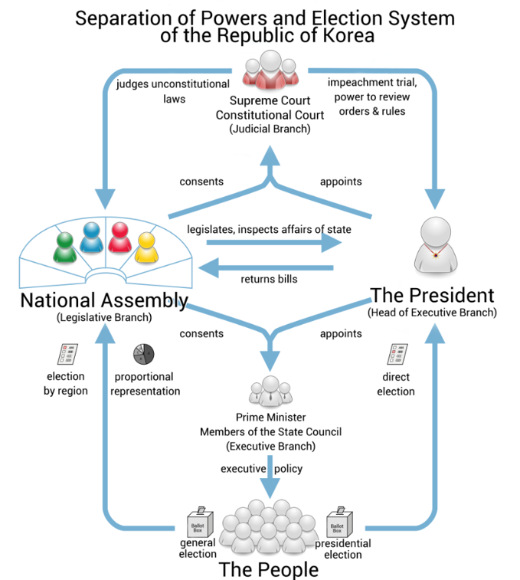

Slide 13
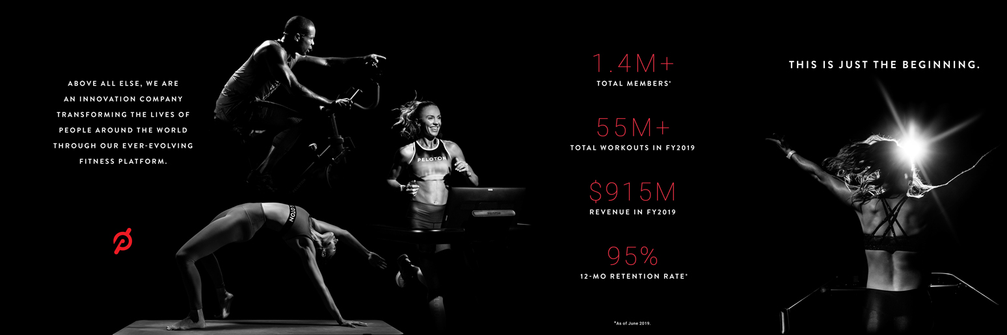




Financial Overview
Key findings:
ROE steadily improved over past 3 years
Samsung Health currently leads ROE among the competitors
Peloton's Growth Story:
Despite starting below Samsung Health, Peloton has shown significant progress in ROE.
Peloton's improving ROE reflects effective management and financial health
Competitive Landscape:
Comparison with Kakao VX and Naver Smart Health also highlights Peloton's competitive standing.
Implications for Market Entry:
Peloton's upward trend in ROE suggests strong potential for success in the South Korean Market
Strategic positioning and financial health are key strengths for Peloton's entry strategy.

Slide 14

Key Financial Ratios
Revenue
2021: $4.02 billion
2022: $3.58 billion
2023: $2.80 billion
Net Income
2021: -$189 million
2022: -$2.83 billion
2023: -$1.26 billion
Return on Equity
2023: 173.90%
Return on Assets
2021: -61.7%
2023: -29.3%
Return On Invested Capital
2021: -92.23%
2023: -39.94%
Notes:
As we can see, Peloton's revenue has been fluctuating over the past three years, starting at $4.02 billion in 2021, then dropping to $3.58 billion in 2022, and further declining to $2.80 billion in 2023.
Peloton's net income has shown significant negative values, with losses growing from -$189 million in 2021 to a staggering -$2.83 billion in 2022. There was a slight improvement in 2023, but the company still faced a loss of -$1.26 billion.
ROE (Return on Equity): In 2023, Peloton had an exceptionally high ROE of 173.9%. This might indicate substantial leverage or unique financial structures used by the company.
ROA (Return on Assets): The ROA figures were negative in 2021 and 2023, at -61.7% and -29.3% respectively, reflecting the challenges Peloton faced in generating profits relative to its total assets.
ROIC (Return on Invested Capital): Peloton also had negative ROIC figures, which were -92.23% in 2021 and improved to -39.94% in 2023. This indicates difficulties in generating returns on total capital invested.

Slide 15




Competitors
Samsung Health:
Part of Samsung's ecosystem
Focuses on fitness and health
Healcerion:
Medical and health technology company
Has fitness applications
SoulCycle:
Known for its fitness studios and cycling classes.
Revenue growth can be found in financial reports or market analysis specific to the fitness industry.
Financial Comparisons:
Revenue Growth: How fast is each company's health and fitness segment expanding?
Market Capitalization and Financial Health: Comparing Peloton's market position against these companies.
Investment in R&D and Technology: Critical for a tech-based fitness company like Peloton

Slide 16
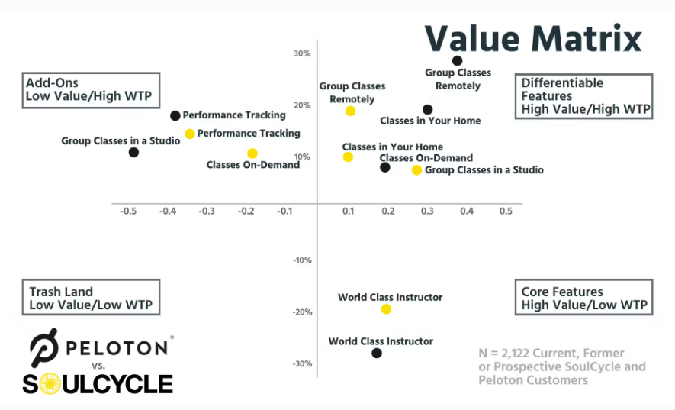
Notes:
The value matrix compares how Peloton and SoulCycle position their offerings in terms of perceived value and customer willingness to pay (WTP). The "Low Value/High WTP" quadrant signifies products that customers are willing to pay a premium for despite perceiving their intrinsic value as relatively low. This typically happens due to strong brand loyalty, unique emotional benefits, or perceived prestige associated with the product.
Peloton’s Positioning: Peloton falls into this quadrant because, despite the high cost of its products, users perceive significant additional value beyond the hardware itself. Peloton has built a dedicated following through a combination of high-quality hardware, engaging live and on-demand classes, and a strong sense of community. The emotional connection users feel with the brand and its instructors significantly increases their willingness to pay. Moreover, owning a Peloton is often seen as a status symbol, adding to the perceived value. This strategic positioning explains why Peloton can command high prices while maintaining strong customer loyalty. Understanding this helps us in strategizing Peloton's entry into the South Korean market, focusing on building similar brand appeal and community connections.
Choosing the Image: I chose this image to highlight how Peloton and SoulCycle, though not currently competitors in the South Korean market, exemplify future competition dynamics. This comparison helps illustrate the potential challenges and strategic considerations Peloton might face as it expands internationally.

Slide 17
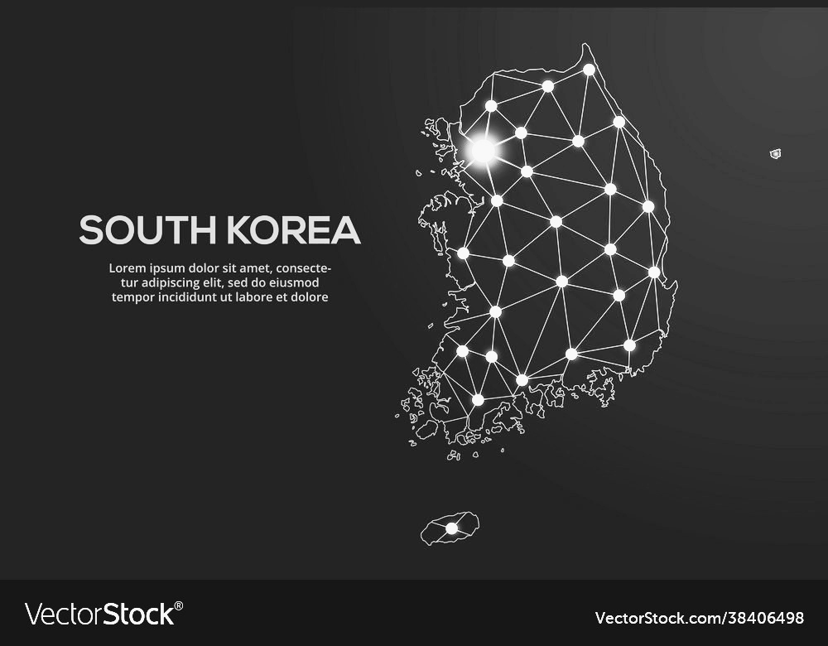
Geographic considerations
Urbanization and population density
Advanced technological infrastructure
Strategic location and regional connectivity

Slide 18
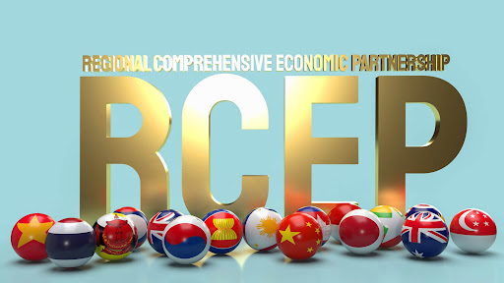
Trade Blocks in South Korea
Asia-Pacific Economic Cooperation (APEC)
Regional Comprehensive Economic Partnership (RCEP)
ASEAN Plus Three
United States-Korea Free Trade Agreement (KORUS FTA)
Notes:
South Korea's Role: As a member of APEC, South Korea participates in promoting balanced, inclusive, sustainable, innovative, and secure growth while accelerating regional economic integration.
Reduced Tariffs and Trade Barriers: ADVANTAGE FOR PELOTON’S EXPANSION
RCEP: This trade agreement significantly reduces tariffs on 91% of goods traded between member countries, making it cheaper and easier for Peloton to import and export products. It also simplifies trade regulations and reduces non-tariff barriers
ASEAN Plus Three - This framework aims to foster economic cooperation and integration in East Asia.
KORUS FTA: A bilateral trade agreement between South Korea and the United States, effective since 2012. It aims to reduce tariffs, remove trade barriers, and promote economic cooperation.

Slide 19
Advantages for Peloton's Expansion
Enhanced Supply Chain Efficiency
Enhanced Intellectual Property Protection
Investment Protections
Notes:
Regional Supply Chains: RCEP encourages the development of regional supply chains, making it more efficient for Peloton to source components and manufacture products within the region. This can lead to cost savings and quicker time-to-market for new products​
Brand and Innovation Protection: The agreement strengthens the protection and enforcement of intellectual property rights. This is crucial for Peloton to safeguard its brand, proprietary technology, and digital content in South Korea​
Secure Operations: KORUS FTA includes provisions that protect investors and ensure fair treatment, reducing the risks associated with foreign investments. This security encourages Peloton to invest in marketing, customer support, and local operations in South Korea​

Slide 20
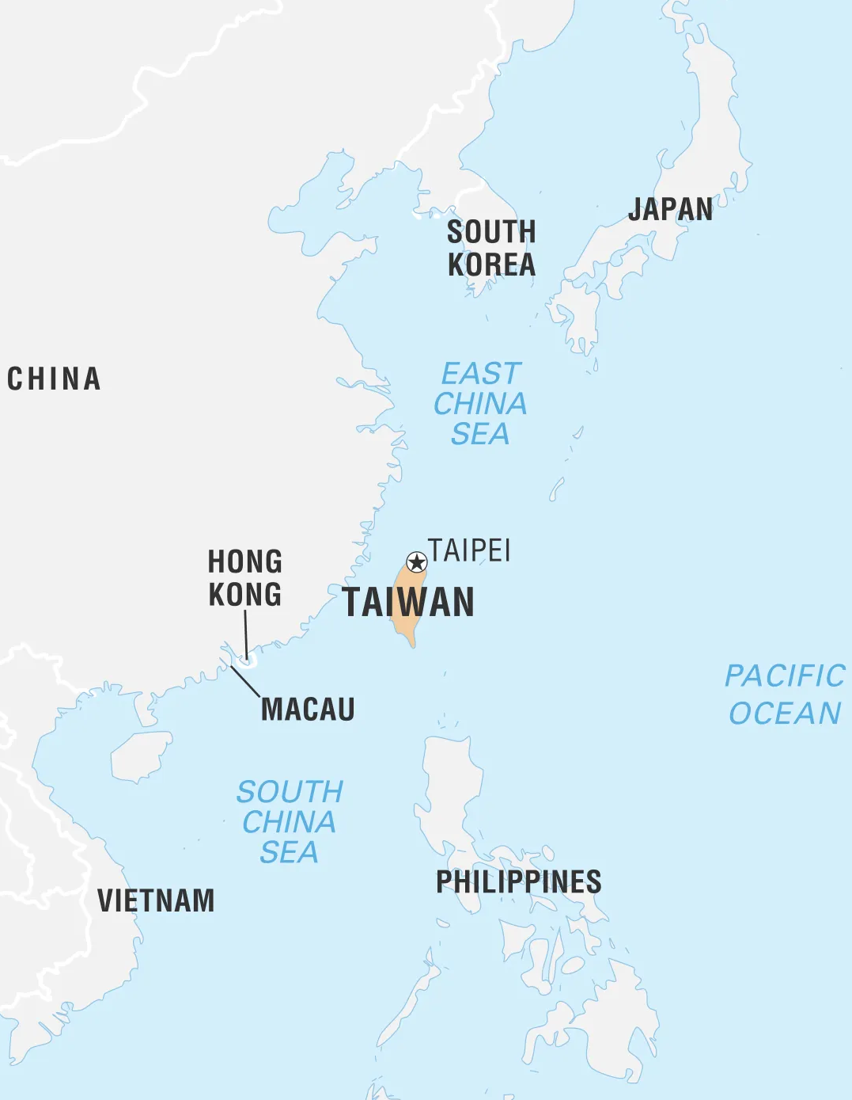
Would Products be sent from Taiwan to South Korea?
Current Geopolitical Context
Geographical Proximity
Economic Relations
Notes:
Geographical Proximity:
Short Shipping Times: The close proximity allows for quick shipping times, which is beneficial for maintaining a steady supply chain and reducing lead times.
Established Routes: Well-established maritime and air routes ensure reliable transportation under normal circumstances.
Economic Relations:
Strong Trade Relations: Taiwan and South Korea have strong trade relations, which support efficient and cost-effective logistics operations.
Advanced Infrastructure: Both Taiwan and South Korea have advanced port and logistics infrastructure, facilitating smooth operations.
Cons of Shipping from Taiwan to South Korea
Geopolitical Risks:
Potential Disruptions: Tensions between Taiwan and China could escalate, leading to disruptions in shipping routes through the Taiwan Strait.
Increased Costs: Higher insurance premiums and security measures due to geopolitical risks can increase overall shipping costs.
Supply Chain Vulnerabilities:
Dependence on a Single Route: Relying heavily on shipping routes through potentially contested areas increases vulnerability to disruptions.

Slide 21
Mitigation Strategies
Multiple Suppliers
Alternative Routes
Buffer Stocks
Notes:
To balance the benefits and risks, Peloton can implement several strategies:
Diversify Supply Chains:
Multiple Suppliers: Source components from multiple countries to reduce dependency on any single region.
Alternative Routes: Identify and utilize alternative shipping routes that avoid the most contentious areas.
Inventory Management:
Buffer Stocks: Maintain higher levels of inventory to cushion against potential disruptions.
Advice:
No, it is not advisable for Peloton to rely solely on shipping products from Taiwan to South Korea due to current geopolitical tensions. Diversifying supply chains and implementing risk mitigation strategies are recommended to ensure stability and resilience.

Slide 22
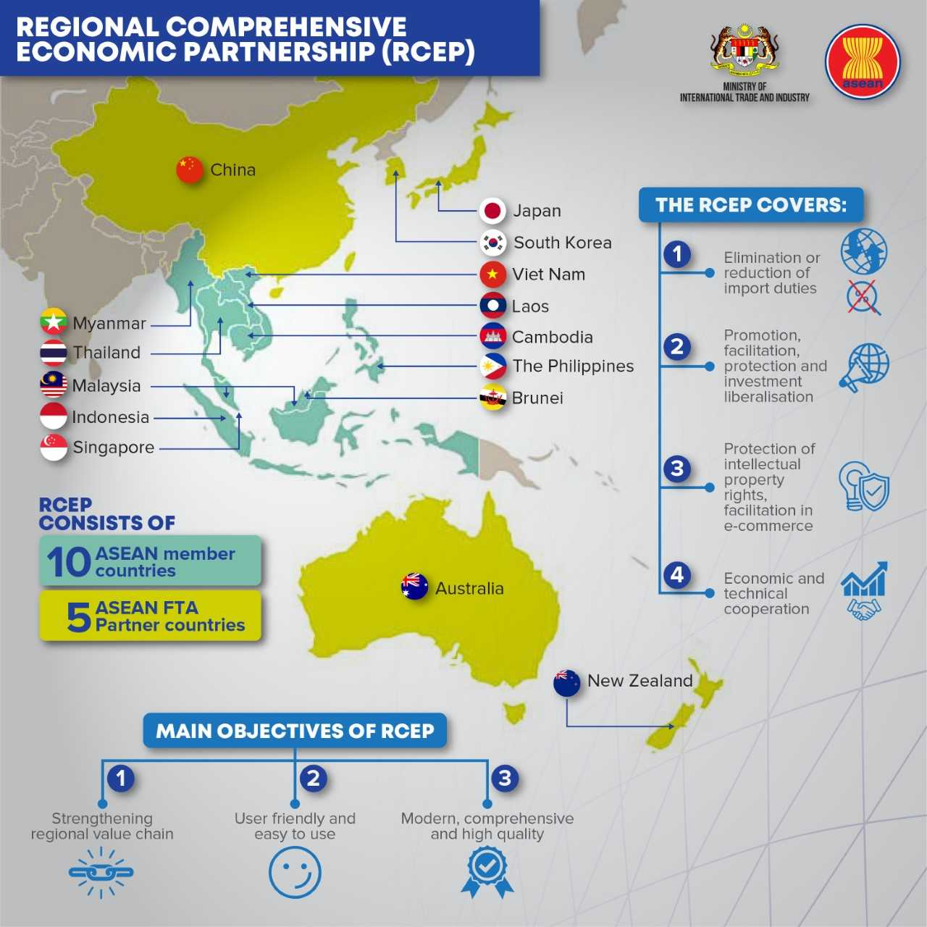

Slide 23



Economic considerations
Income & purchasing power
Customer profile
Market overview

Slide 24
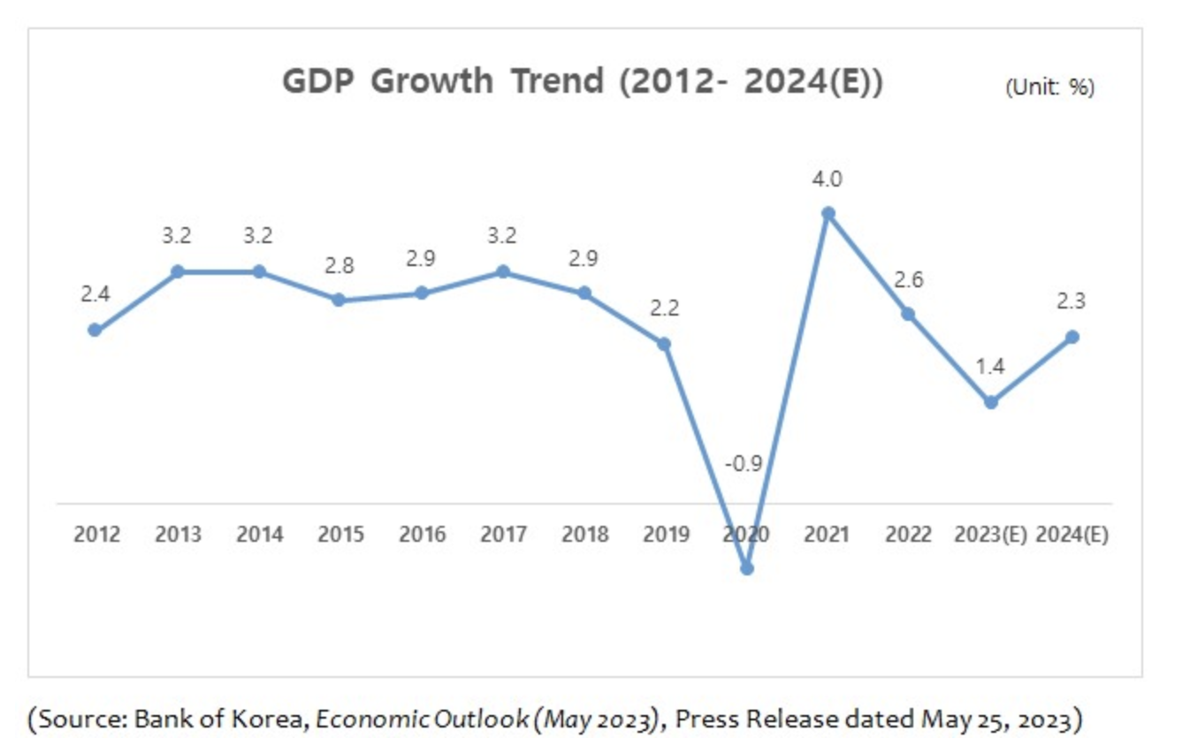
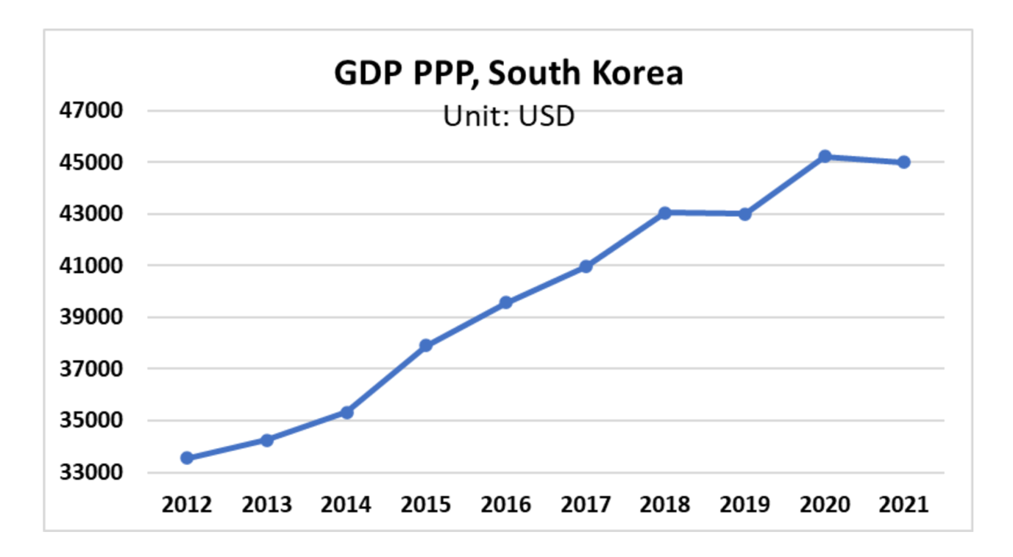
Stable Growth
Notes:
• Stable Growth (2012-2019): GDP growth rates remained relatively stable, fluctuating between 2.2% and 3.2%.
• Pandemic Impact (2020): A significant decline in 2020 with a GDP growth rate of -0.9%, reflecting the global economic impact of the COVID-19 pandemic.
• Strong Recovery (2021): A sharp rebound to 4.0% in 2021 as the economy recovered from the pandemic.
• Post-Recovery Deceleration (2022-2023): Growth slowed down to 2.6% in 2022 and further to a projected 1.4% in 2023.
• Slight Recovery (2024): A moderate recovery is projected with a GDP growth rate of 2.3% in 2024.

Slide 25
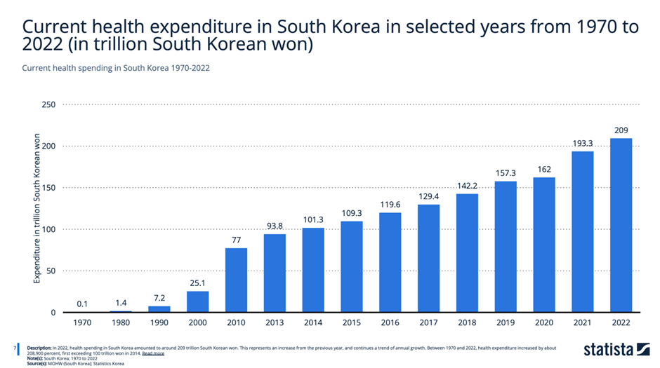
Defined Growth
Notes:
1,000 South Korean Won is equivalent to approximately 0.72 USD as of June 15 2024.
209 Trillion South Korean Won is approximately a $151,086,956,900 market (~$151 Billion)

Slide 26
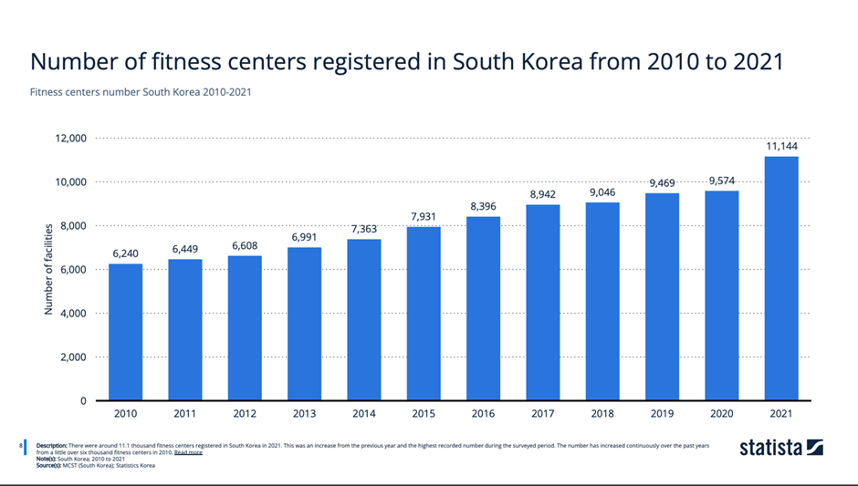
Established Foundation

Slide 27
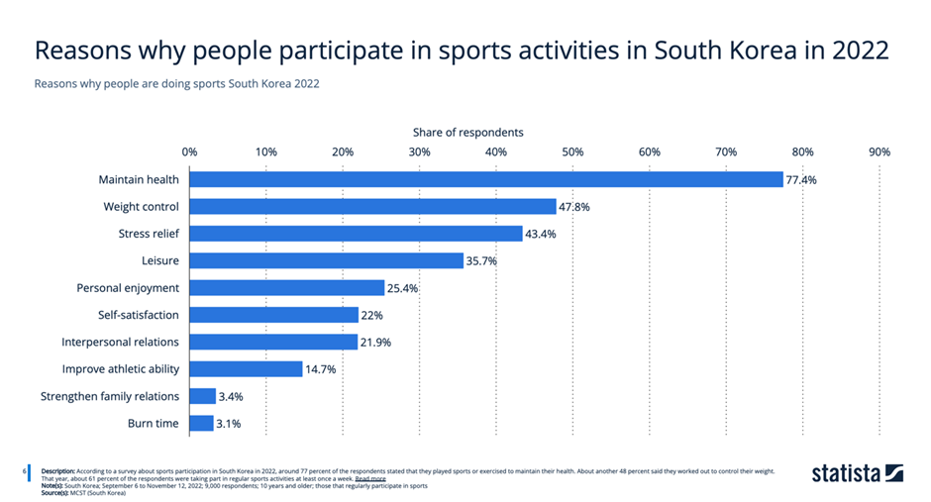
Motivated Customer base

Slide 28
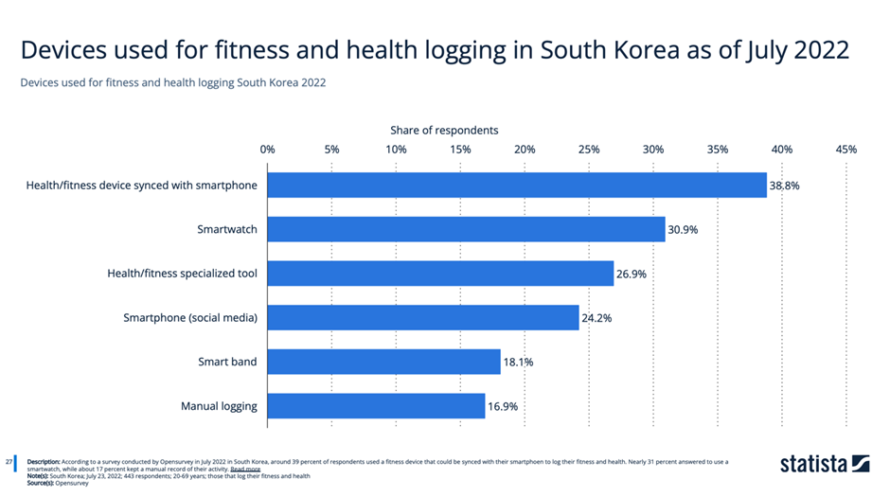
Cultural Acceptance

Slide 29
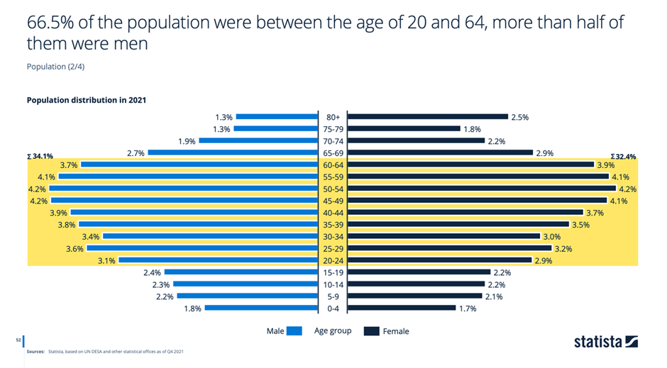
South Korea Market Demographics
Notes:
HAND OFF TO SARA

Slide 30
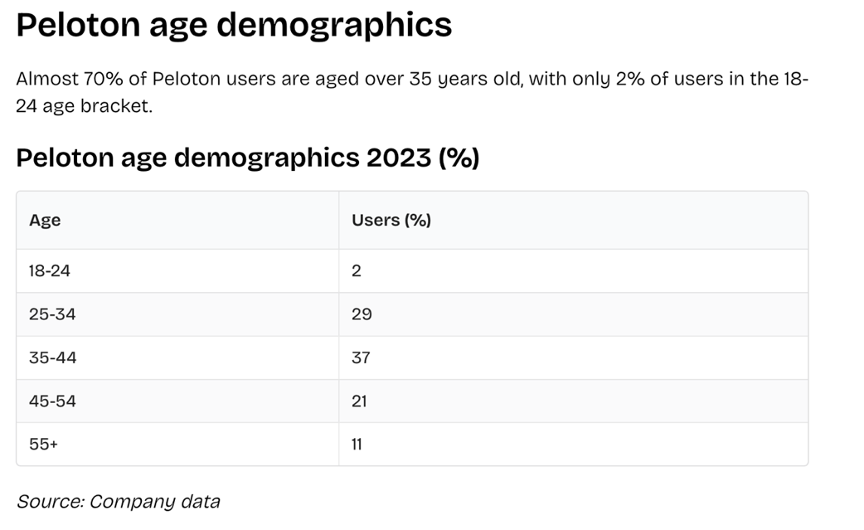
Peloton user age demographics

Slide 31

INTB6200
THANK YOU
Anna Sromek, Brittany Isenhart, Chris Lyons, Rachit Pandya, Rishabh Sharma, and Sara Sherindil

